Slide 1


The International Society of Primerus Law Firms
presents in cooperation with
Association of Corporate Counsel Europe:
How to Maximize Communication in Multi-Lingual Discussions
by Brödermann Jahn („Primerus Germany“ in Hamburg)
www.German-law.com
Prof. Dr. Eckart Brödermann LL.M. (Harvard), Maître en droit (Paris)
Member of the Bars of Hamburg, Germany and New York,
Professor at the University of Hamburg
14.06.2017

Slide 2

Welcome! Bon jour! Guten Tag!
Multi-Lingual Communication | 14.06.2017 | Page 2
A modern In-house counsel in global waters ...
… with multi-lingual trade and discussions

Slide 3
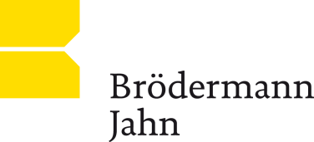
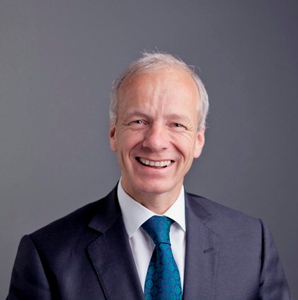
To whom do you listen?
Multi-Lingual Communication | 14.06.2017 | Page 3
3000 Lawyers
50 countries (175 offices)
Long-time ACC partner
Sponsor of the ACC International Committtee
25 (international) Jurists in Hamburg
5 language desks (www.german-law.com)
Active worldwide (ca. 20 jd p. week)
Your Primerus face:
Eckart Brödermann, ’80, ’81 (Paris), ’83 (Harvard), ’87 (Hamburg), FCIArb (London),
Bar Certified Specialist for International Economic Law
Global practice (trade, investment, M&A, arbitration),
Consultant and Arbitrator, Founder of Brödermann Jahn
Professor at University of Hamburg / Board Hamburg Bar
Fluent in German, French, Globish, Italian; +

Slide 4
Assumptions
Multi-Lingual Communication | 14.06.2017 | Page 4
Some of you know the trouble, pain and effort of learning a foreign language
Some of you speak only English (or American?)
All of you have had multi-language experiences
Multi-lingual Business negotiations
You are aware of the problems and risks of multi-language communication.

Slide 5
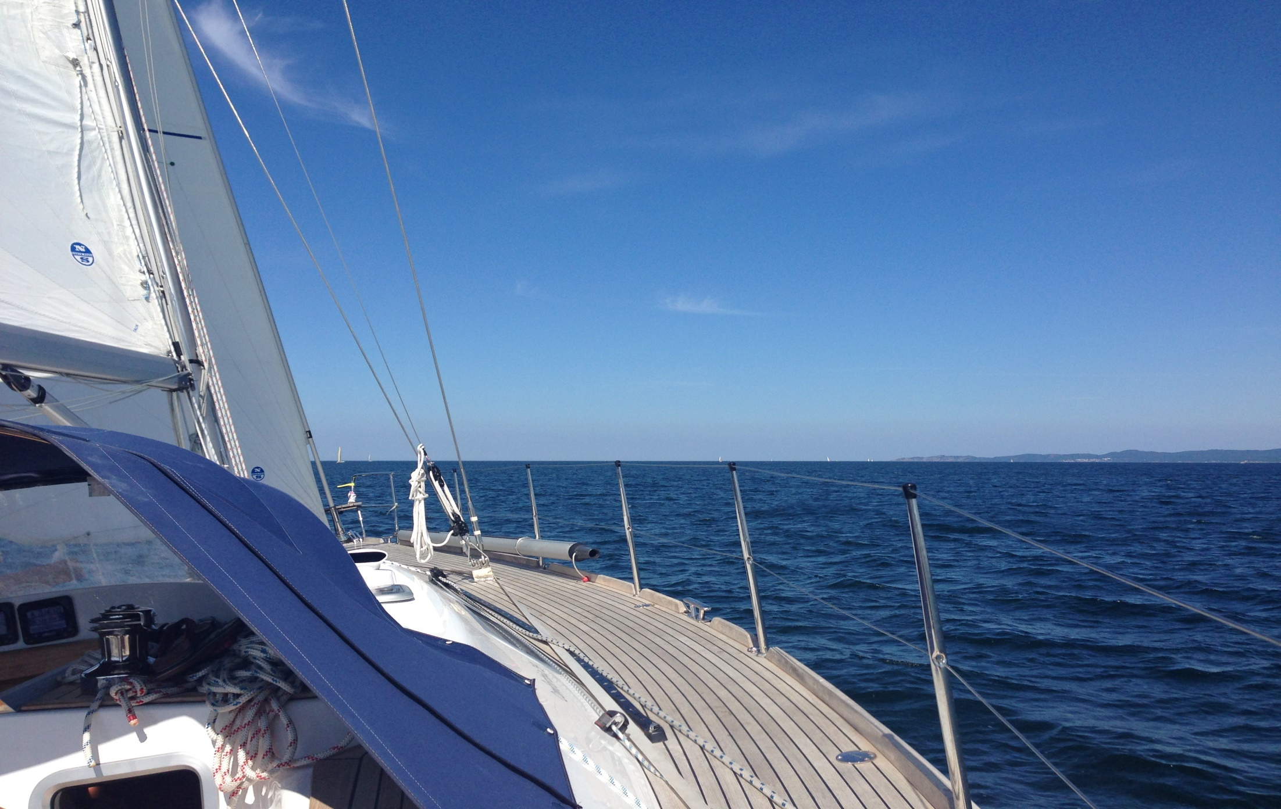
How to Maximize Communication in Multi-Lingual Discussions - Agenda
Multi-Lingual Communication | 14.06.2017 | Page 5
Chances and Risks of Multi-Lingual Discussions (negotiations)
Risk Assessment
Tools (‘How to …’) for different scenarios

Slide 6

A. Chances of multi-lingual communication
Multi-Lingual Communication | 14.06.2017 | Page 6
Access to additional markets around the globe
Growing business nationally and internationally

Slide 7
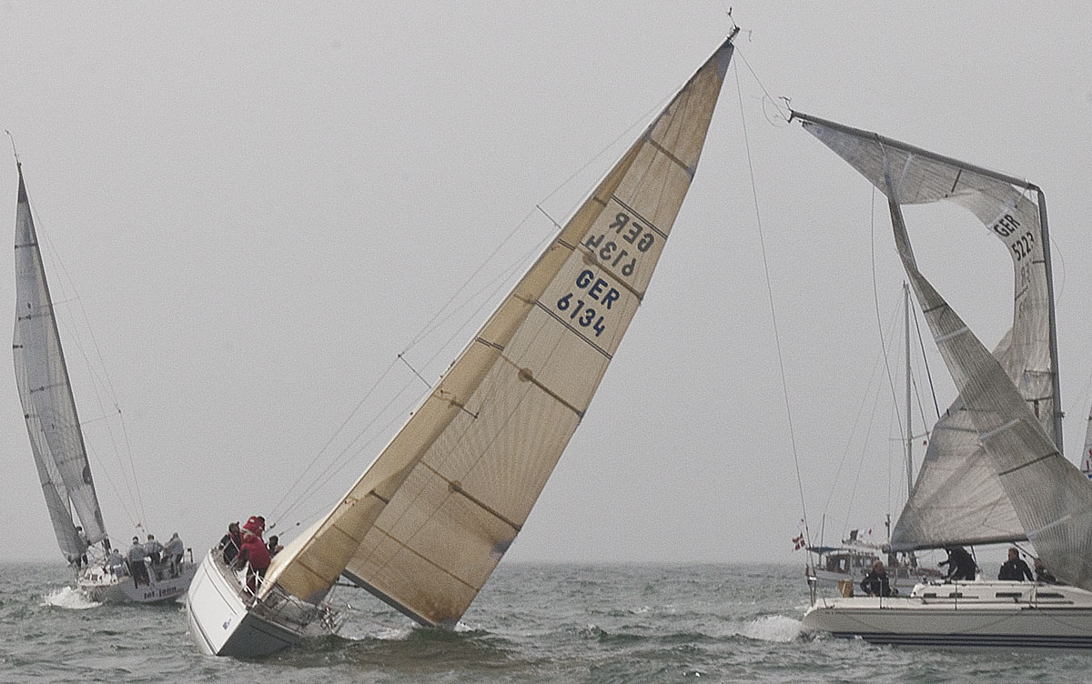
B. Risks (slides 7-29)
Multi-Lingual Communication | 14.06.2017 | Page 7
No Contract
To convince you
Wrong Content
Liability
Delay
Additional Costs
Dispute

Slide 8
B. Risks
Multi-Lingual Communication | 14.06.2017 | Page 8
No Contract
To convince you
Wrong Content
Liability
Risks requires a language management
as diligent contract management
(obligation of CEO as a matter of company law)
Delay
Additional Costs
Dispute

Slide 9
B. Risks: Overview
Multi-Lingual Communication | 14.06.2017 | Page 9
In the Original Language
In the Translation
In the System of Interpretation
RISKS
originating
RISKS
originating
originating
RISKS

Slide 10

1. Risk originating in the Original Language (I)
Multi-Lingual Communication | 14.06.2017 | Page 10
العربية
中文
Русский
Differences between Languages:
Different developments of language
function of words
English (171,476 words in current use) v. German
options to combine words
German (quasi unlimited) v. English
syntax
expression of time (Mandarin)

Slide 11
1. Risk originating in the Original Language (II)
Multi-Lingual Communication | 14.06.2017 | Page 11
e.g. Arabic (العربية) - French (Algeria)
English –
the various Chinese languages
Differences between Languages
Different developments of language
Different function of words
English (171,476 words in current use) v. German
Different options to combine words.
German (unlimited) v. English
Different syntax.
Different expression of time (Mandarin)

Slide 12

1. Risk originating in the Original Language (III)
Multi-Lingual Communication | 14.06.2017 | Page 12
Language as an Expression of Culture.
Even of legal culture.

Slide 13
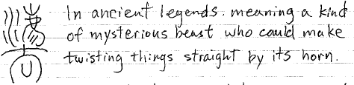
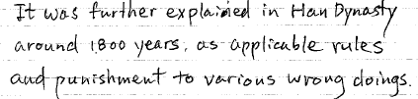

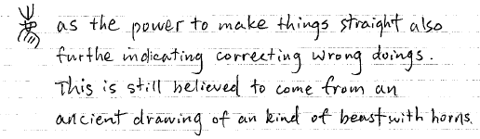

Multi-Lingual Communication | 14.06.2017 | Page 13
Risk originating in the Original Language (III)
Example: The Chinese „Fa“ (=LAW) (1)

Slide 14

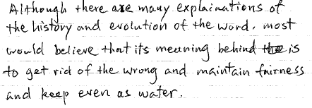
1. Risk originating in the Original Language (III) Example: The Chinese „Fa“ (=LAW) (2)
Multi-Lingual Communication | 14.06.2017 | Page 14
From James Wu, a Chinese lawyer from Beijing (visiting in November 2014)

Slide 15
1. Risk originating in the Original Language (III) Example: The Chinese „Fa“ (=LAW) (3)
Multi-Lingual Communication | 14.06.2017 | Page 15
Reprimand side of law
Distinct from a
positive perspective
inspired by party autonomy
From James Wu, a Chinese lawyer from Beijing (visiting in November 2014)

Slide 16

2. Risks originating in the Translation (I)
Multi-Lingual Communication | 14.06.2017 | Page 16
Google is not enough!
Conveying the true meaning
Often a lawyer’s job (negotiate the price!)
Costs can therefore be substantial!

Slide 17
2. Risks originating in the Translation (II)
Multi-Lingual Communication | 14.06.2017 | Page 17
Canadian – Algerian example
Italian example
Google is not enough!
Conveying the true meaning
often a lawyer’s job (negotiate the price!)
Costs can therefore be substantial!

Slide 18
2. Risks originating in the Translation (III)
Multi-Lingual Communication | 14.06.2017 | Page 18
Translation of Legal Terms
e.g. all similar to a German ear:
‘guaranty’, ‘warranty’, ‘representation’, ‘indemnity’
‘liquidated damages’, penalty clauses proper
e.g. English too risky for German law?
But there is often ‘no alternative’

Slide 19
2. Risks originating in the Translation (IV)
Multi-Lingual Communication | 14.06.2017 | Page 19
Embedding foreign legal terms into a language
Words may look like English but which do have a distinct meaning by referring to foreign concepts
example: Change of Control of a foreign legal entity
Translation does not make a cross-border matter national (‘wrong’ feeling of security)

Slide 20

2. Risks originating in the Translation (V)
Multi-Lingual Communication | 14.06.2017 | Page 20
Risk of ‘No Agreement’
If, through translation, parties agree to different terms, there may by ‘no meeting of the minds’ and thereby (partially) ‘no consent’
This can entail invalidity of the the entire contract

Slide 21

3. Risks in the System of Interpretation: Common versus Civil Law (I)
Multi-Lingual Communication | 14.06.2017 | Page 21
Example: New York (‘Plain meaning of the words’) Greenfield v. Philles Records, 98 N.Y.2d 562, 569-570 (2002).
The best evidence of what parties to a written agreement intend is what they convey in their writing. Thus, a written agreement that is complete, clear, and unambiguous on its face must be enforced according to the plain meaning of its terms. If an agreement on its face is reasonably susceptible of only one meaning, a court is not free to evaluate extrinsic evidence to determine the parties’ intent. … (Precedents)

Slide 22
3. Risks in the System of Interpretation: Common versus Civil Law (II)
Multi-Lingual Communication | 14.06.2017 | Page 22
Example: New York (‘Plain meaning of the words’) Greenfield v. Philles Records, 98 N.Y.2d 562, 569-570 (2002).
The best evidence of what parties to a written agreement intend is what they convey in their writing. Thus, a written agreement that is complete, clear, and unambiguous on its face must be enforced according to the plain meaning of its terms. If an agreement on its face is reasonably susceptible of only one meaning, a court is not free to evaluate extrinsic evidence to determine the parties’ intent. … (Precedents)
as a sample for common law
systems around the globe
(e.g. Australia, Singapore,
Hong Kong, Nigeria)

Slide 23
3. Risks in the System of Interpretation (III)
Multi-Lingual Communication | 14.06.2017 | Page 23
Counter-Example Germany
§ 133 Civil Code ‘BGB’: Interpretation of a declaration of intent
When a declaration of intent is interpreted, it is necessary to ascertain the true intention rather than adhering to the literal meaning of the declaration.
§ 157: Interpretation of contracts
Contracts are to be interpreted as required by good faith, taking customary practice into consideration.

Slide 24
3. Risks in the System of Interpretation (IV)
Multi-Lingual Communication | 14.06.2017 | Page 24
Counter-Example Germany
§ 133 Civil Code ‘BGB’: Interpretation of a declaration of intent
When a declaration of intent is interpreted, it is necessary to ascertain the true intention rather than adhering to the literal meaning of the declaration.
§ 157: Interpretation of contracts
Contracts are to be interpreted as required by good faith, taking customary practice into consideration.
as a sample for civil law
systems of German origin
(incl. e.g. Greece, China, Japan)
or French origin
(e.g. Portugal, South America,
Egypt, Qatar)

Slide 25
4. Risks in the System of Interpretation (V)
Multi-Lingual Communication | 14.06.2017 | Page 25
UNIDRPOIT Principles – compromise in Art. 4.1
A contract shall be interpreted according to the common intention of the parties.
(2) If such an intention cannot be established, the contract shall be interpreted according to the meaning that reasonable persons of the same kind as the parties would give to it in the same circumstances.

Slide 26
4. Risks in the System of Interpretation (VI)
Multi-Lingual Communication | 14.06.2017 | Page 26
UNIDRPOIT Principles – compromise in Art. 4.3
In applying Articles 4.1 …, regard shall be had to all the circumstances, including
(a) preliminary negotiations between the parties;
(b) practices which the parties have established between themselves;
(c) the conduct of the parties subse­quent to the conclusion of the contract;
(d) the nature and purpose of the contract;
(e) the meaning commonly given to terms and expressions in the trade concerned;
(f) usages.

Slide 27
4. Risks in the System of Interpretation (VII)
Multi-Lingual Communication | 14.06.2017 | Page 27
While Art. 2.1.17 permits
merger clauses which deviate
from lit. a)
UNIDRPOIT Principles – compromise in Art. 4.3
In applying Articles 4.1 …, regard shall be had to all the circumstances, including
(a) preliminary negotiations between the parties;
(b) practices which the parties have established between themselves;
(c) the conduct of the parties subse­quent to the conclusion of the contract;
(d) the nature and purpose of the contract;
(e) the meaning commonly given to terms and expressions in the trade concerned;
(f) usages.

Slide 28
5. Example for an Assessment (I)
Multi-Lingual Communication | 14.06.2017 | Page 28
Examples for Multi-Lingual Communication in legal matters: A = NY / B = Germany
 | native speaker from B
 | (also native in A) | Trained solely in law B | Trained in law B with additional legal training in law A | Trained in law B with additional general legal comparative training or experience
native speaker from A
Trained solely in law A
Trained in law A with additional legal training in law B
Trained in law A with additional general legal comparative training or experience

Slide 29
5. Examples for an Assessment (II) Variations
Multi-Lingual Communication | 14.06.2017 | Page 29
Examples for Multi-Lingual Communication in legal matters: A = NY / B = Germany
 | Client + | native speaker from B (lnhouse/extern)
 |  | Trained solely in law B | Trained in law B with additional legal training in law A | Trained in law B with additional general legal comparative training or experience
native speaker from A (lnhouse/extern) + Client
Trained solely in law A
Trained in law A with additional legal training in law B
Trained in law A with additional general legal comparative training or experience

Slide 30

C. Risk Assessment: Overview
Multi-Lingual Communication | 14.06.2017 | Page 30
Step 1: Assesing the Need of Translation
Step 2: Budget constrains

Slide 31

C. Risk Assessment (I)
Multi-Lingual Communication | 14.06.2017 | Page 31
Assessing the Need of Translation and its Importance for the process of the project
Business Needs
Legal Needs

Slide 32
C. Risk Assessment (II)
Multi-Lingual Communication | 14.06.2017 | Page 32
Business Needs
Who needs to communicate with whom?
Who needs to understand what?
Where can you work with abstracts ? (costs)

Slide 33
C. Risk Assessment (III)
Multi-Lingual Communication | 14.06.2017 | Page 33
Legal Needs
Legal (e.g. constitutional) requirements regarding the language of the contract (e.g. in Algeria)
Laws on the language in courts (e.g. in most state courts)
Under German Law: Para. 184 S. 1 German Court Constitution Act (GVG)
Assesing the legal relevance of documents

Slide 34
C. Risk Assessment (IV)
Multi-Lingual Communication | 14.06.2017 | Page 34
Understanding the law: equality of several languages and its impact on understanding the law (Europe / multiple German examples of wrong translation of the law) (Subject to ….) (a coma …)

Slide 35
C. Risk Assessment (V)
Multi-Lingual Communication | 14.06.2017 | Page 35
Thinking ahead: Dispute Resolution Regime consequences of different options
translation costs (clause on annexes)
evidence taking (costs and risks)
risks of interpretation

Slide 36
C. Risk Assessment (VI)
Multi-Lingual Communication | 14.06.2017 | Page 36
Assessing the Impact of Translation Errors
Probability
of Realisation
Probable Amount of Damage
De minimis
slight
critical
disastrous
often
probable
sometimes
seldom
unlikely
Not imaginable

Slide 37
C. Risk Assessment (VII)
Multi-Lingual Communication | 14.06.2017 | Page 37
Assessing the Impact of Translation Errors
Probability
of Realisation
Probable Amount of Damage
Example of Annexes,
often understimated
(example: google translated
marketing
materials in annexes)
De minimis
slight
critical
disastrous
often
probable
sometimes
seldom
unlikely
Not imaginable

Slide 38
C. Risk Assessment (VIII)
Multi-Lingual Communication | 14.06.2017 | Page 38
2. Budget Constraints

Slide 39
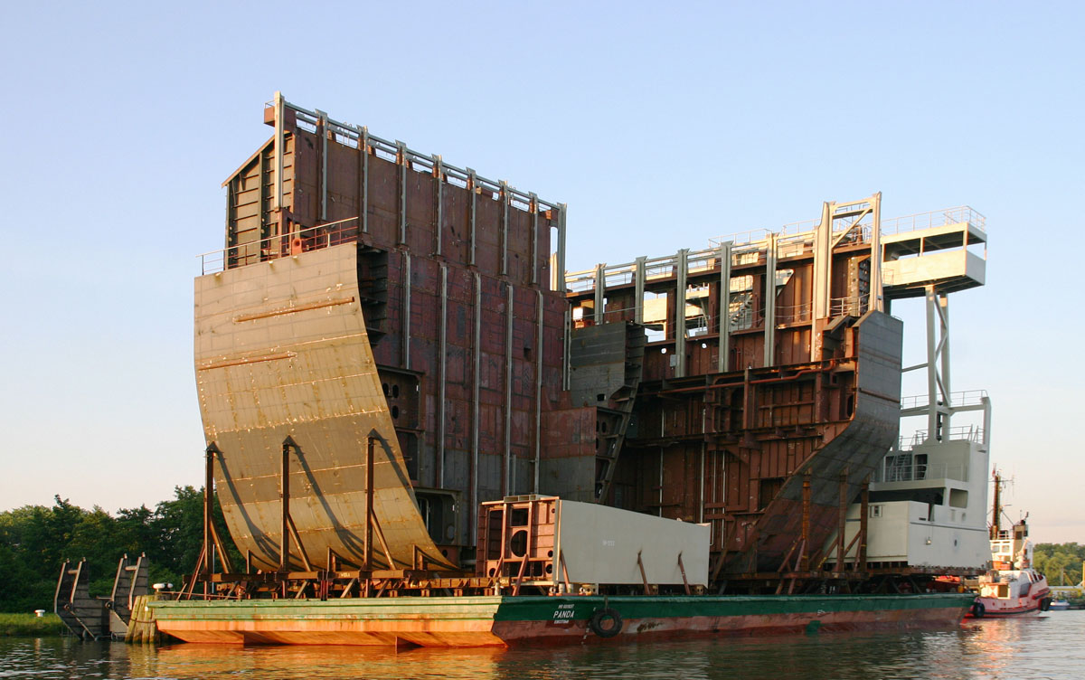
D. Tools to Overcome the Risks: Overview
Multi-Lingual Communication | 14.06.2017 | Page 39
Legal Level
Internal Level
External
Commu-nication

Slide 40
D. Tools to Overcome the Risks – Internal level
Multi-Lingual Communication | 14.06.2017 | Page 40
1. Internal level:
Raise the Awareness of the Risks with the Stakeholders in the Project
Determine your linguistic options (team intern/extern)
lawyer: Language + Comparative legal thinking
Organise the necessary budget

Slide 41
D. Tools to Overcome the Risks – Legal Level (I)
Multi-Lingual Communication | 14.06.2017 | Page 41
2. Legal level:
A Wake-Up Call:
think out of the box
create solutions as appropriate under the circumstances.
soft law offers.
language management

Slide 42
D. Tools to Overcome the Risks – Legal Level (II)
Multi-Lingual Communication | 14.06.2017 | Page 42
b) Choice of the dispute resolution regime
Over 1000 arbitration regimes to chose from
Market oriented, different skill sets (e.g. ICC, CEAC)
Shaping the competence of the arbitrators (and the costs!), including language skills
Shaping the regime for evidence taking (costs)
the chance to ‘internationalise’ a language (e.g. English law and German or Swiss arbitration)

Slide 43
D. Tools to Overcome the Risks - Legal Level (III)
Multi-Lingual Communication | 14.06.2017 | Page 43
c) Choice of Legal Rules
Example: UNIDROIT Principles of International Commercial Contracts (2010 or 2016 edition, as released in April 2017)
211 rules in neutral language
Example: ‘non-performance’ instead of ‘breach of contract’
Rules are ‘made to measure’ for cross-border trade
> 50 compromises between civil and common law
an example for international legal communication (in combination with an arbitration clause )

Slide 44
D. Tools to Overcome the Risks - Legal Level (IV)
Multi-Lingual Communication | 14.06.2017 | Page 44
d) Interdependence between the dispute resolution regime and the choice of law

Slide 45
D. Tools to Overcome the Risks - Legal Level (V)
Multi-Lingual Communication | 14.06.2017 | Page 45
e) Formulation of the Contract
Clear language
Original words in brackets
(always thinking ahead for the worst case from the perspective of the mind chosen as decision maker)
Short sentences

Slide 46
D. Tools to Overcome the Risks Legal Level (VI)
Multi-Lingual Communication | 14.06.2017 | Page 46
f) Special Clauses (Triebel)
„This Agreement has been prepared by German lawyers against a German commercial and legal background. If any term of the Agreement is open to interpretation, the intended German meaning shall prevail.”
„English […] is not the native language of the parties and of their advisors [one of the parties or its advisers]. The parties have agreed to English in the contract as a language of convenience [party X has agreed to English in the contract as a concession to party Y]”

Slide 47
D. Tools to Overcome the Risks - Legal Level (VII)
Multi-Lingual Communication | 14.06.2017 | Page 47
Special Clauses (Triebel) cont’d.
This Agreement shall be executed in a spirit of good faith and commercial loyalty [or: fair dealing]. Any questions of interpretation which might occur in light of the different native language of the parties (to whom English is a foreign language of convenience) shall also be resolved in that spirit of good faith with due regard to the circumstances of the making of this Agreement.”

Slide 48
D. Tools to Overcome the Risks - Legal Level (VIII)
Multi-Lingual Communication | 14.06.2017 | Page 48
g) Special Cases
The documentation of the understanding of decision makers who do not speak the language of the document:
Integrating a statement in his native language in the document
Documenting the translation
Informing about the (legal) risk allocation
Example of German notary law

Slide 49
D. Tools to Overcome the Risks - Legal Level (IX)
Multi-Lingual Communication | 14.06.2017 | Page 49
h) Hierarchy Clauses
To create hierarchy for the documents in which real translation efforts went into.

Slide 50
D. Tools to Overcome the Risks - Legal Level (X)
Multi-Lingual Communication | 14.06.2017 | Page 50
i) Clauses to reduce costs in case of dispute
Definition of languages in which evidence may be submitted
Presumption of correctness of office translations
Rebuttal possible by concrete objections from the other party

Slide 51
D. Tools to Overcome the Risks - Communication
Multi-Lingual Communication | 14.06.2017 | Page 51
3. Communication:
Organise who speaks with whom when in what function and in what language (e.g. Merkel-Putin in Russian)
Official translation situations (a chance to think)

Slide 52
Thank you! Merci! Danke!
Questions? Ideas?
Prof. Dr. Eckart Brödermann
Rechtsanwalt
Brödermann Jahn RA GmbH (www.german-law.com, in 5 languages including Chinese)
ABC-Strasse 15
20354 Hamburg

